Slide 1
EET 495 Theater Proposal
Presented by:
Software:
Austin Bechtel
Patrick Dudczyk
Mohammed Abdulwahab
Hardware:
Nick Sjoberg
Yasser Alharthi
Hassan Alkhwaildi

Slide 2
Overview
Purpose:
The purpose of the project is to move limited amount of scene, custom, objects or sometimes actors in a limited amount of weight. The robot must be programmed to be controlled wirelessly and be able to navigate the stage in a limited distance.
Implementing this project:
This is going to make an incredible scenery mover for the theater department & save money because it is much less than the retailer price

Slide 3
Overview
Protection:
Safety break:
must detect the object nearby the robot and make a slow movement brake.
Over load protection:
if the weight more than what it should be an alarm alert visible in the control stage.
Battery life:
It has a limited life battery. Must of the time it is going to be in standby which is good. But most of the scene goes for hours that the robot could be use at any time.

Slide 4
Problem Statement
To design, implement, and enhance an automated stage robotic system to carry numerous scenes and sets to various programmed points on the stage floor, while maintaining safety as a number one priority by implementing several safety features.

Slide 5
Background
Current SIU theater program has a lack of automation in their play productions. Implementing an automated scenery robotic system will allow SIU to take their productions to the next level with automation. Prior work has been completed at other universities with similar goals. Through the partnership of the SIU theater program and the Electrical Engineering Technology senior design class, the goal of automation can become a reality. The use of open source software and off the shelf components will allow easy replication and improvement of the project.

Slide 6
Project Objectives
Design an easy to use PC based user interface
Establish wireless communication from PC to robot platform
Create wireless safety protocol
Establish smooth motion control of robot via USB joystick
Utilize dog fence for edge of stage detection
Create ESTOP system with multiple triggers
Deadman switch on joystick
Loss of PC to robot connection
Edge of stage detection
UI stop button
Mechanical switch on robot
Actor/Object detection

Slide 7
Strategy
The team is divided to two groups:
Software group
Develop sample program utilizing My Open Lab and Arduino
Develop basic codes
Hardware group
Evaluate hardware component choices
System integration and testing

Slide 8
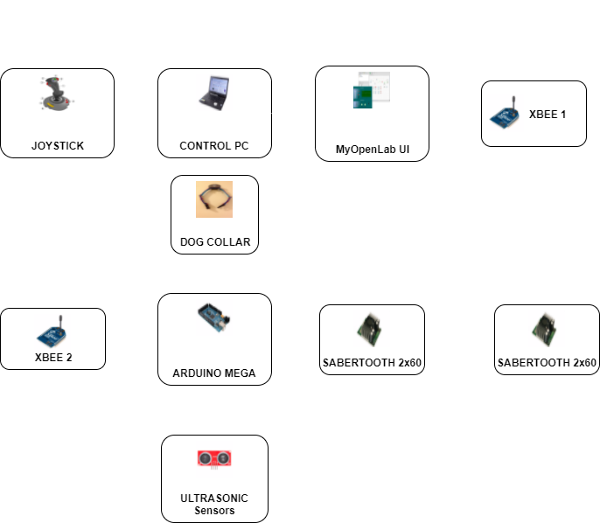
Strategy

Slide 9
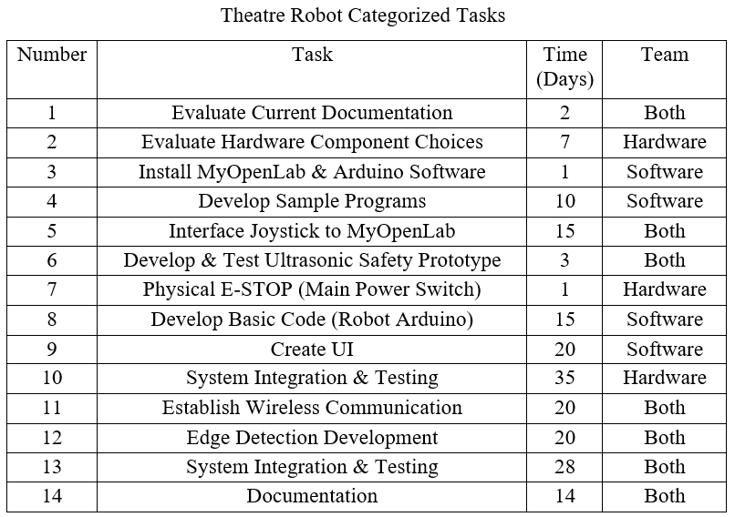
Action Plan

Slide 10
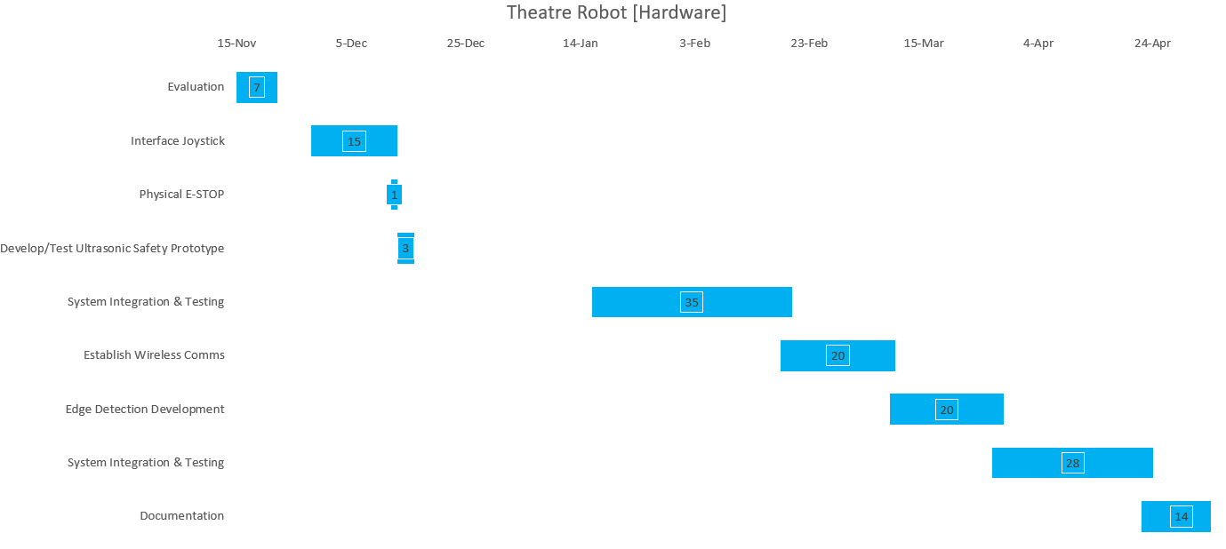
Action Plan

Slide 11
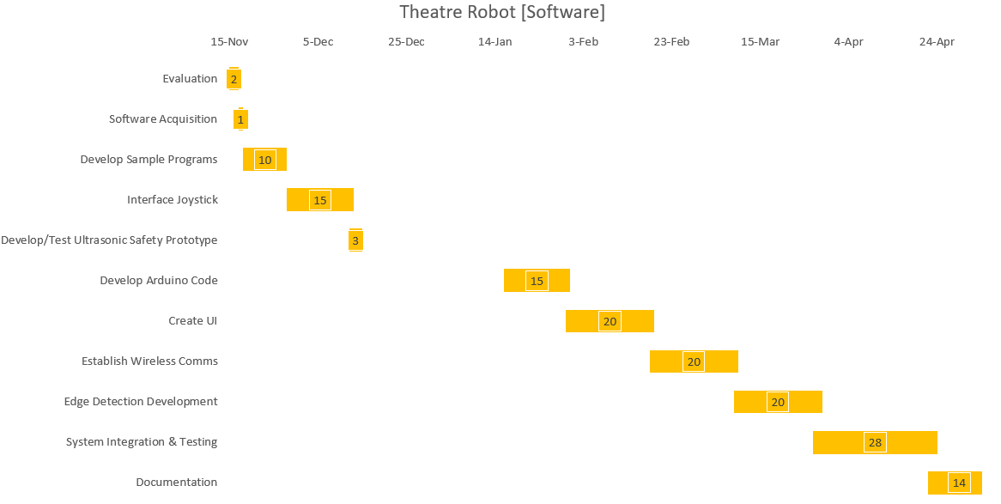
Action Plan

Slide 12
Results Reporting
Monthly written report presents:
What was done since last report
What is being done so far
What will be done next

Slide 13
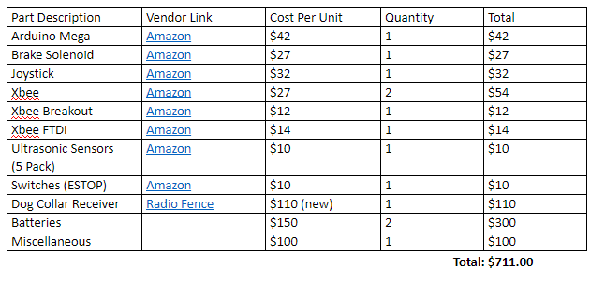
Budget

Slide 14
Personnel
Please see each group member's printed qualifications/resume

Slide 15
